Slide 1
Comp 2021 Project Demo: HKUST Course Analysis
Group: Trine
Member: Chan Nok Hin, Cheng Hoi Kei, Sze Ka Yu

Slide 2

Objective
To help students get prepared for course registration
Showing detailed information about each course
Reduce time in considering courses which are unlikely to be enrolled in
By predicting the “full moment” of the courses using past data
Easily find out the time slot which the courses will usually be full already
(currently only involves COMP courses)

Slide 3
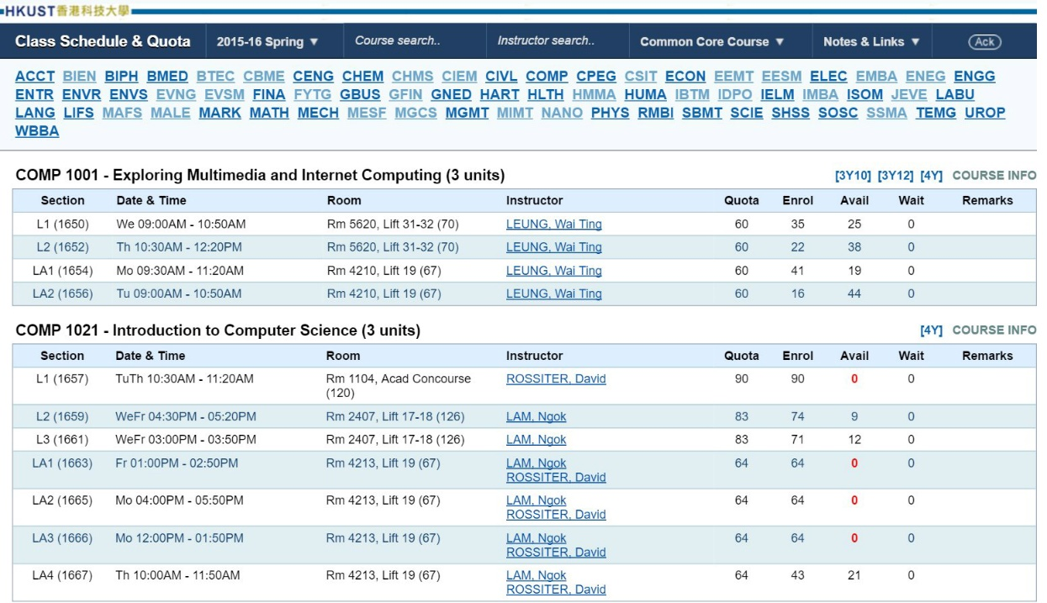
Features
Filtering
Easier to get the required course
Graph
Simple representation of the enrollment situation
When clicked, a web page containing detailed information will be opened
Detailed Information & Data
According to HKUST Class Schedule & Quota
E.g. course description, requirement, etc

Slide 4


Tools used
PHP Storm
PHP: Getting data, generating graph, etc
Dreamweaver
HTML & CSS: Layout and background
JavaScript: Filtering and other functions

Slide 5
Difficulty
Many

Slide 6
Solution
Mighty Google

Slide 7
END

